Slide 1
Programming Fundamentals
By
Shazmeen Batool

Slide 2
Previous Lecture
Nested loop
Break
Continue

Slide 3
Today’s Lecture
Basics of Arrays
Declaring Arrays
Initializing Arrays
Accessing Arrays
Processing Arrays

Slide 4
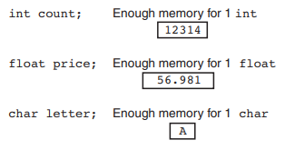
Array
An array allows you to store and work with multiple values of the same data type.
The variables you have worked with so far are designed to hold only one value at a time.

Slide 5
Array
An array works like a variable that can store a group of values, all of the same type. The values are stored together in consecutive memory locations.
For example: we need to store the marks of 100 students.
Instead of declaring individual variables, such as marks0, marks1, . . . , and marks99, you declare one array with a name such as marks.

Slide 6
Declaring Arrays
To declare an array, you need to specify its element type (data type) and size using the following syntax:
elementType arrayName[SIZE];
The elementType can be any data type, and all elements in the array will have the same data type.
The SIZE, known as array size declarator, must be a constant integer greater than zero therefore, it is fixed.

Slide 7
Declaring Arrays
The number inside the brackets is the array’s size declarator. It indicates the number of elements, or values, the array can hold.
For example: we need to store the marks of 100 students; the syntax would be as follows:
int marks[100];

Slide 8

Class Activity
Define the following arrays:
empNums, a 100-element array of ints
payRates, a 25-element array of floats
lightYears, a 1,000-element array of double s

Slide 9
Class Activity
What’s wrong with the following array definitions?
int readings[-1];
Array sizes must be non-negative integers. A negative size (-1) is invalid and will cause a compile-time error.
float measurements[4.5];
Array sizes must be integer constants. 4.5 is a floating-point number, so this is invalid.

Slide 10
Initializing Arrays
Arrays may be initialized when they are defined.
Like regular variables, C++ allows you to initialize an array’s elements when you create the array.
The series of values inside the braces and separated with commas is called an initialization list. These values are stored in the array elements in the order they appear in the list.
int marks[4]= {1,2,3,4};

Slide 11
Initializing Arrays
C++ allows you to omit the array size when declaring and creating an array using an initializer.
int marks[]= {1,2,3,4};
Because the size declarator is omitted, C++ counts the number of items in the initialization list and gives the array that many elements.
You must provide an initialization list if you leave out an array’s size declarator. Otherwise, C++ doesn’t know how large to make the array.

Slide 12
Initializing Arrays
int marks[4];
marks[0]=1;
marks[1]=11;
marks[2]=33
marks[3]=4;
This is called element-wise initialization or assignment after declaration.
It means you're declaring the array first (without initial values), and then assigning values to each element one by one using their indices.
This way is useful when you need to set values later in the program, but it requires more lines of code.

Slide 13
Initializing Arrays
Below syntax gives an error
int marks[];
marks[0]=1;
marks[1]=11;
marks[2]=33
marks[3]=4;

Slide 14
Initializing Arrays
int marks[4]= {1,2};
C++ allows you to initialize a part of the array. For example, the above statement assigns values 1, 2 to the first two elements of the array named marks. The other two elements will be set to zero.
If you leave an element uninitialized, you must leave all the elements that follow it uninitialized as well. C++ does not provide a way to skip elements in the initialization list.

Slide 15
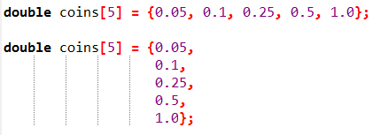
Initializing Arrays
C++ allows you to spread the initialization list across multiple lines. Both of the following array definitions are equivalent:
Note: If an array is declared, but not initialized, all its elements will contain “garbage,” like all other local variables.

Slide 16
Accessing Array Elements
The individual elements of an array are assigned unique subscripts also known as index. These subscripts are used to access the elements.
A subscript is used as an index to pinpoint a specific element within an array. The first element is assigned the subscript 0, the second element is assigned 1, and so forth.
Subscript numbering in C++ always starts at zero. The subscript of the last element in an array is one less than the total number of elements in the array

Slide 17
Accessing Array Elements
For example we have an array: int marks[10];
marks[0]=10; means the value of first element of array = 10;
Similarly marks[9] = 20; means the value of last element of array = 20;
Point to note: when we declare array such as int marks[10], the square brackets contain the size of the array while after declaration when we use this array, such as marks[4] than square brackets contain the position of element and marks[4] mean the element which lies at 5th position.

Slide 18
Accessing Array Elements
Understand the difference between the array size declarator and a subscript.
The number inside the brackets of an array definition is the size declarator.
The number inside the brackets of an assignment statement or any statement that works with the contents of an array is a subscript.

Slide 19

Representation of an array
int marks[5];
marks[0] = 1;

Slide 20

Representation of an array
int marks[5];
marks[0] = 1;
marks[1] = 33;

Slide 21

Representation of an array
int marks[5];
marks[0] = 1;
marks[1] = 33;
marks[2] = 12;

Slide 22

Representation of an array
int marks[5];
marks[0] = 1;
marks[1] = 33;
marks[2] = 12;
marks[3] = 5;

Slide 23
Representation of an array
int marks[5];
marks[0] = 1;
marks[1] = 33;
marks[2] = 12;
marks[3] = 5;
marks[4] = 21;

Slide 24
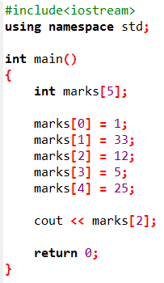

Activity 1
Output

Slide 25

Memory Allocation
int marks[5];
The compiler allocates the space for 5 int type elements for array named marks.
All the elements of the array are stored in Contiguous memory locations.

Slide 26
Memory Allocation
The name of the array contains the address of 1st element of array.
cout<<marks;
Print 0x0 on the screen.

Slide 27
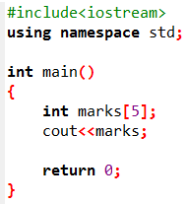
Memory Allocation
Output

Slide 28
Inputting and Displaying Array Contents

Slide 29
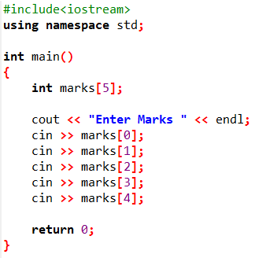
cout can be used to display values from an array.
cin can be used to store values into an array.

Slide 30
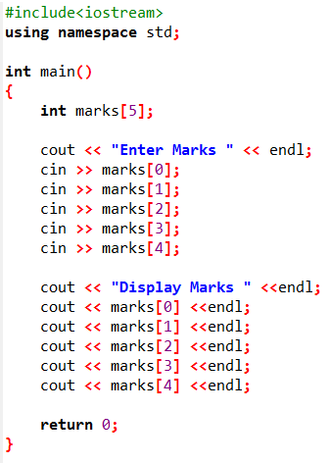
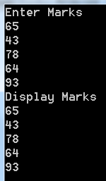
Output

Slide 31
Processing Arrays
When processing array elements, you will often use a for loop—for the following reasons:
All of the elements in an array are of the same type. They are evenly processed in the same way using a loop.
Since the size of the array is known, it is natural to use a for loop.

Slide 32
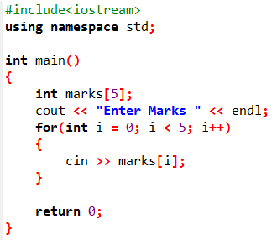
The following loop initializes the array marks with user input values

Slide 33
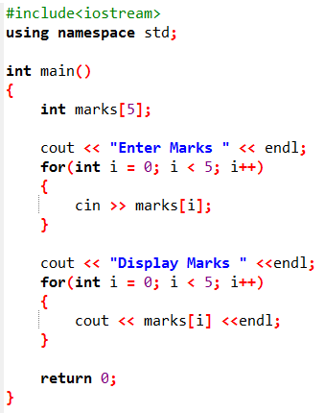
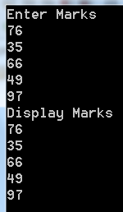
Activity 2

